Slide 1

Heart Disease Classification
Machine Learning Project
Heart Disease Classification
Machine Learning Project

Slide 2
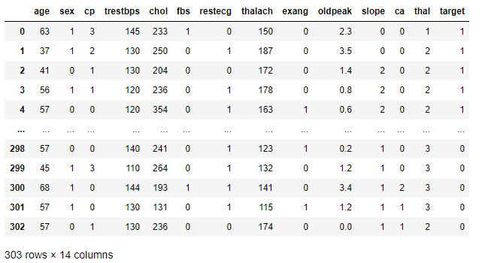

Data Set
76 features 14
Cleveland database - only one with utility
Creators: 1. Hungarian Institute of Cardiology. Budapest: Andras Janosi, M.D. 2. University Hospital, Zurich, Switzerland: William Steinbrunn, M.D. 3. University Hospital, Basel, Switzerland: Matthias Pfisterer, M.D. 4. V.A. Medical Center, Long Beach and Cleveland Clinic Foundation: Robert Detrano, M.D., Ph.D.
https://archive.ics.uci.edu/ml/datasets/Heart+Disease

Slide 3
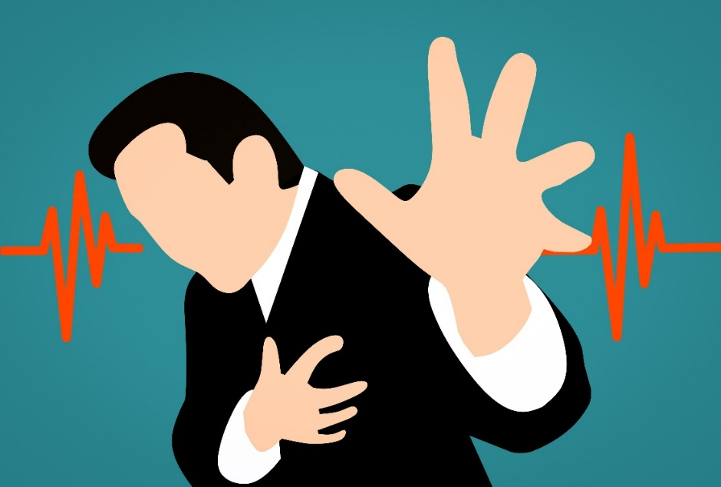
Data Set – Features
cp: chest pain
trestbps: resting blood pressure (normal 120/80 mm Hg )
chol: cholesterol (normal less than 170 mg/dl)
fbs: fasting blood sugar (normal below 100)
restecg: resting EKG
thalach: max. heart rate (normal: 220 minus age)
exang: exercise induced angina
oldpeak: exercise induced ST depression relative to rest
slope: the slope of the peak exercise ST segment
ca: the number of major vessels colored by fluoroscopy
thal: an inherited blood disorder „thalassemia”
target: heart disease (0: no, 1: yes)
https://www.heart.org/en/health-topics/heart-attack/angina-chest-pain

Slide 4

Interesting facts about human heart
Inside an adult’s body there are 95,000 km of blood vessels. It is over twice of the length of circumference of the globe.
Every day, the average human heart beats around 100,000 times, pumping 7,200 litres (50 bath tubs) of blood through the body.
It’s a lot of work for an organ which is just like a large fist and weighs less than 0,5 kg.

Slide 5
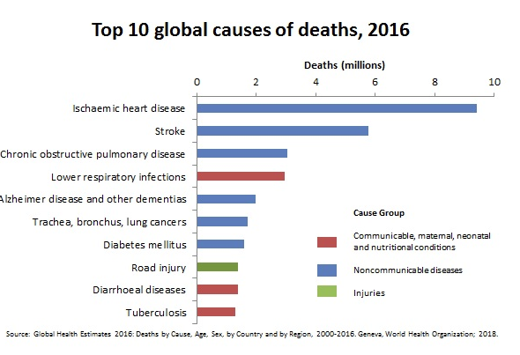
Heart Diseases are number 1 cause of global deaths
Heart disease is responsible for most deaths worldwide for both men and women of all races.
One in four deaths in the United States is due to heart disease of some kind.
Coronary heart disease, also called coronary artery disease, is the most common type and accounts for half of those deaths.

Slide 6
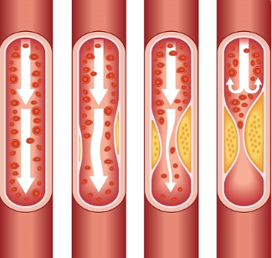
Heart Disease
plaque building up in the arteries and narrowing them
plaque rupture (a blood clot can form on the plaque, blocking the flow of blood)
A heart attack occurs usually when blood clot blocks blood flow to the cardiac. Tissue loses oxygen without blood and dies causing chest pain.

Slide 7


Exploratory
Data Analysis

Slide 8
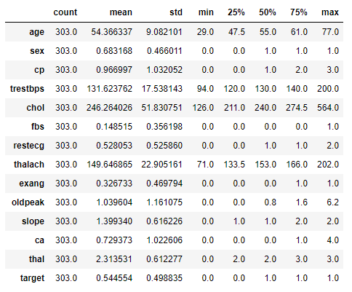
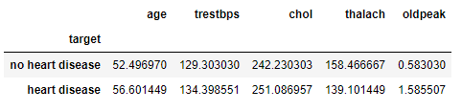
Exploratory Data Analysis
Age 29-77
Trestbps (blood preassure) 94 – 200 / 120
Cholestrol 126 – 564 / 170
Thalach (max. heart rate) 71 – 202 /220-55=165
Average statistics per target value:

Slide 9
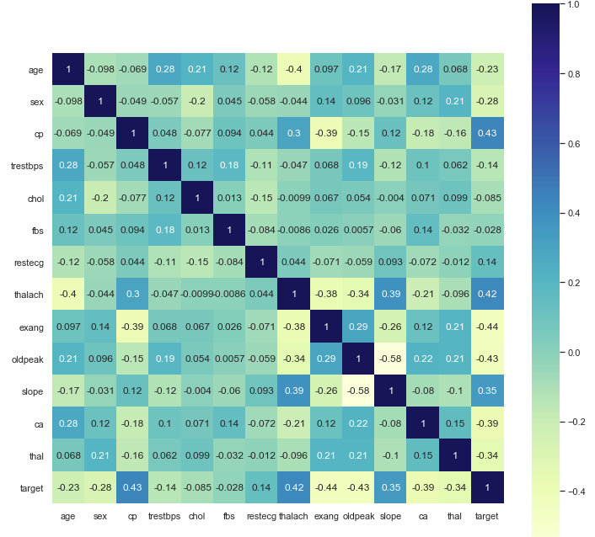
Exploratory Data Analysis
Correleation to target value:
cp (chest pain)
thalach (max. heart rate)
slope (slope of ST)
Reverse correlation to target value:
Exang (exercise induced angina)
Oldpeak (exercise induced ST change)
Ca (nb of major vessels colored by fluoroscopy)
Thal (thalassemia)

Slide 10
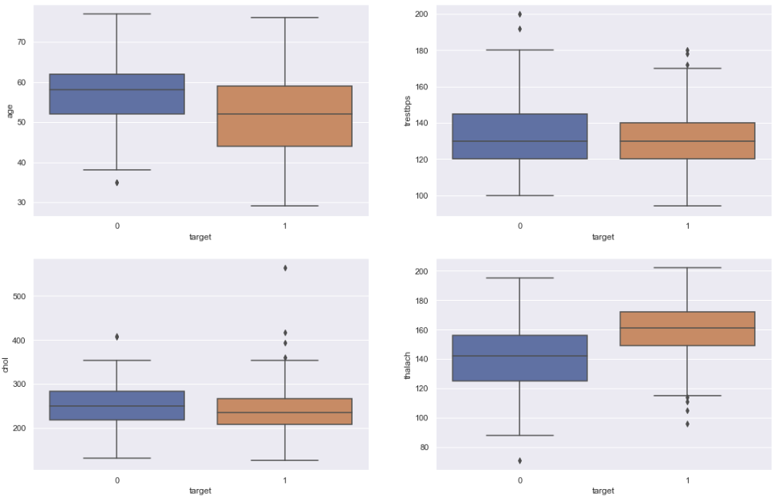
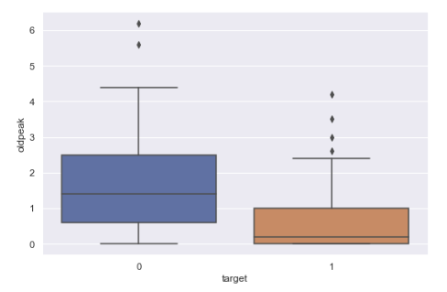
Exploratory Data Analysis
Target vs Features:
Heart disease
No heart disease
Resting blood preassure
Oldpeak (ST)
Age
Cholesterol
Max. Heart rate

Slide 11
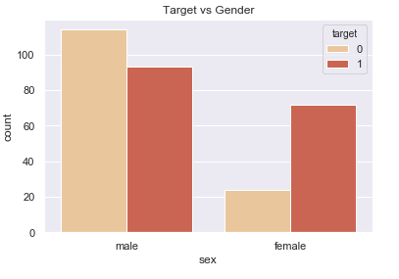
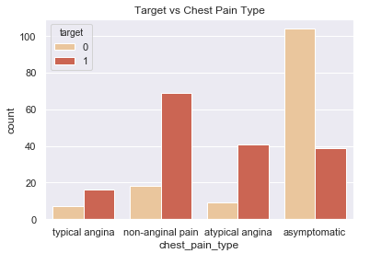
Exploratory Data Analysis
Contrary to man, majority of woman patients from cleveland data set have heart disease.
Woman may have a heart attack with no chest pain, they usually experience nausea or vomiting which are often confused with acid reflux or the flu.
Majority of patients with heart disease have non-anginal chest pain.
Majority of the atypical chest pain is due to other than heart disease problem ex. indigestion, flu, a strained chest muscle.

Slide 12
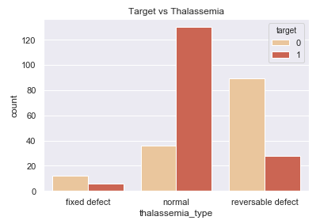
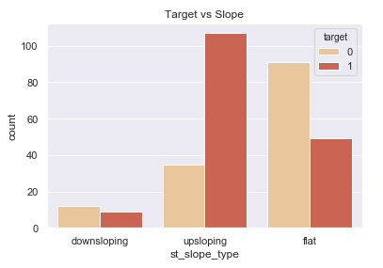
Exploratory Data Analysis
Most of the patients with heart disease have normal Thalassemia type
Those with reversable Thalassemia in majority have no heart disease
Most of the patients with heart disease experience upsloaping ST wile excercising
Flat slope rather characteristic for non heart disease

Slide 13
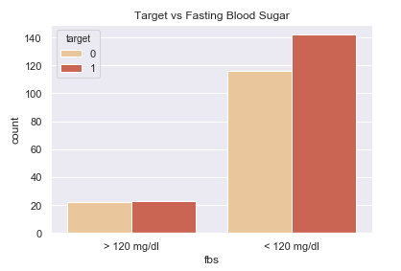
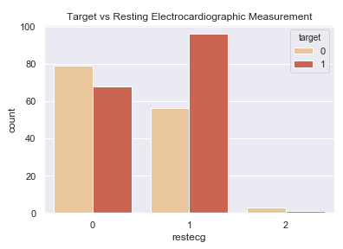
Exploratory Data Analysis
Most of the patients had close to normal (below 100) sugar level which could mean that this feature is not really correlated with heart disease. However it might be a matter of a small sample.
Most of the patients in Cleveland data set have EKG normal (0) or ST-abnormal (1)
Abnormal EKG (1) in more than half cases didn’t cause heart disease
Almost no patients EKG show symptoms of left ventricular hypertrophy (2)

Slide 14
Supervised and Unsupervised
Macchine Learning

Slide 15
Goal and priorities
Classify patients for those who have heart disease and those who don’t
Feature importance
Priority metrics:
- Accuracy
- Recall (we want to minimize FN, patients diagnosed healthy, but being ill in reality)

Slide 16
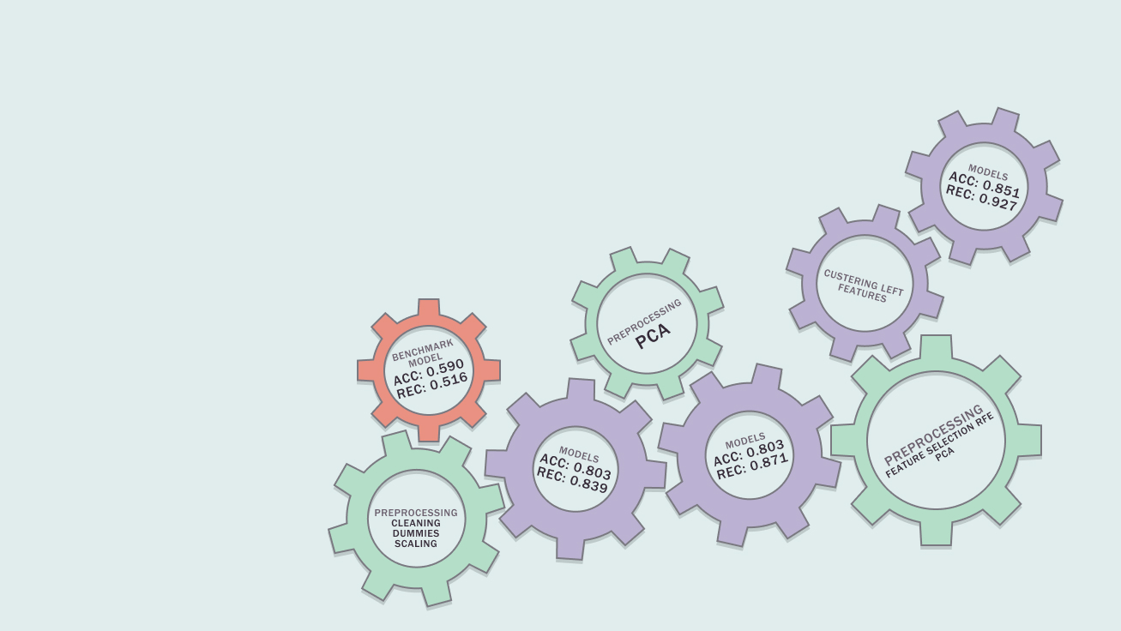
Models Building
Benchmark model
Preprocessing
Dummies
Scaling
Models building
Preprocessing
PCA
Models building
Preprocessing
RFE
PCA
Unsupervised MI
Supervised MI

Slide 17
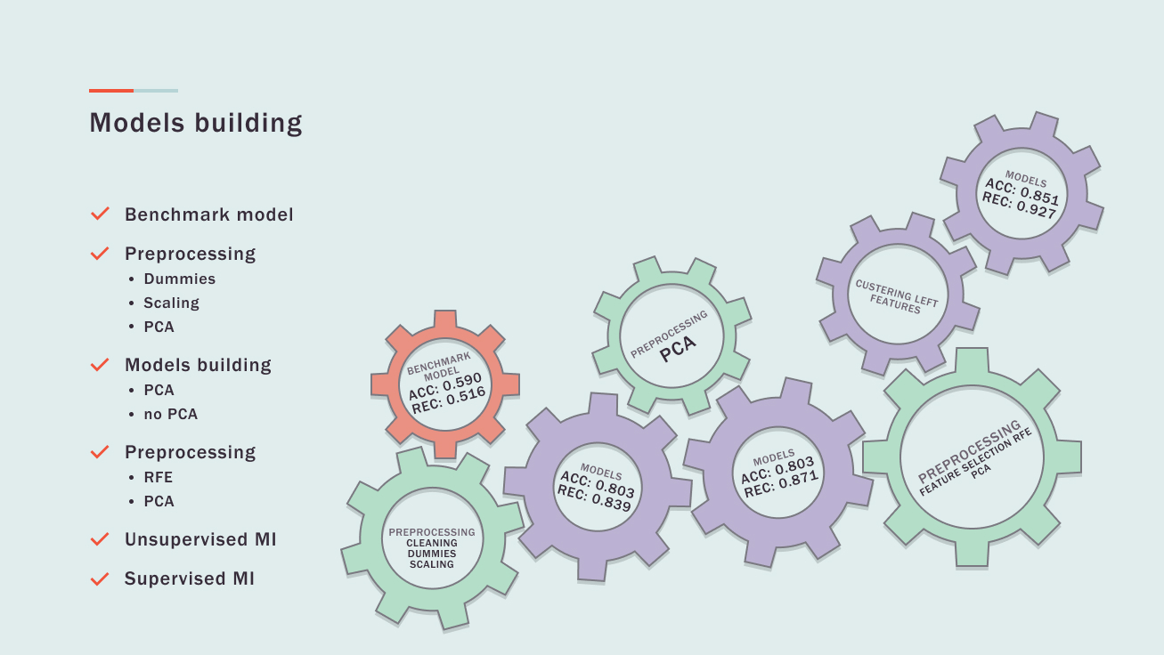

Slide 18

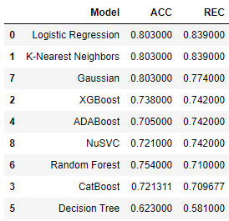
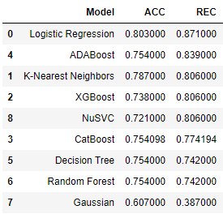
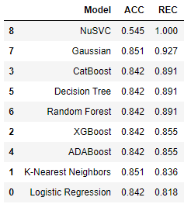
Models Results and Evolution
Benchmark model:
Preprocessing with PCA:
Preprocessing w/o PCA:
RFE + clustering + classyfication:

Slide 19
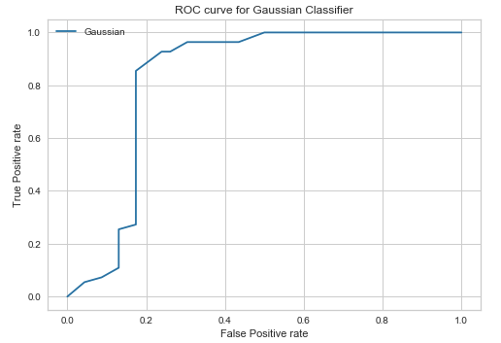
Model choice
Gaussian Naive Bayes
AUC score: 0.84
Model’s Accuracy: 0.851
Model’s Recall score: 0.927

Slide 20
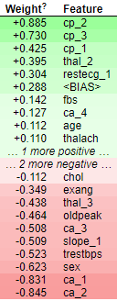
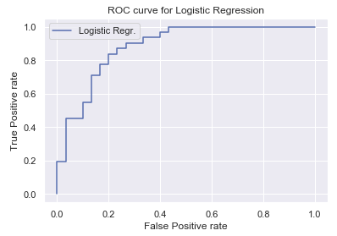
Model choice & Features Explanation
Logistic Regression
The most important features:
Chest pain
Nb of major vessels
Sex
Blood preassure
ST parameter behaviour on EKG
Thalassemia (type 2 and 3)
Features with less importance:
Age (particularity of dataset)
Max. heart rate
Fasting blood sugar
Cholesterol
AUC score: 0.8
Model’s Accuracy: 0.803
Model’s Recall score: 0.871

Slide 21
Thank you, take care!
Heart Disease Classification
Machine Learning Project

Slide 24
Heart Disease Classification
Machine Learning Project

Slide 25

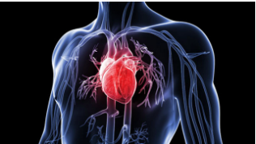
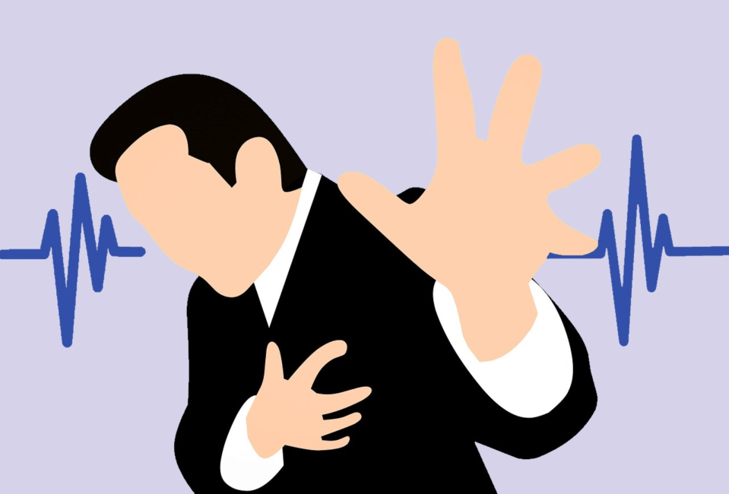
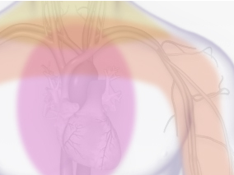

Slide 26
Models Building
Models
Acc: 0.851
Rec: 0.927
Benchmark model
Preprocessing
Dummies
Scaling
Models building
Preprocessing
PCA
Models building
Preprocessing
RFE
PCA
Unsupervised MI
Supervised MI
Preprocessing
- PCA
Clustering left features
Benchmark model
Acc: 0.59
Rec: 0.516
Models
Acc: 0.803
Rec: 0.871
Models
Acc: 0.803
Rec: 0.839
Preprocessing:
Feature Selection RFE
PCA
Preprocessing:
- Cleaning
- Dummies
- Scaling

Slide 27
Data Set – Features
cp: chest pain when heart doesn't get as much blood and oxygen as it needs due to arteries being clogged with plaque and not enough blood can flow through (1: typical angina, 2: atypical angina, 3: non-anginal pain, 4: asymptomatic)
trestbps: resting blood pressure (normal 120/80 mm Hg )
chol: cholesterol (normal less than 170 mg/dl)
fbs: fasting blood sugar (> 120 mg/dl, 1 = true; 0 = false) (normal below 100)
restecg: resting electrocardiographic-EKG (0: normal, 1:ST-T wave abnormality, 2: showing probable or definite left ventricular hypertrophy by Estes' criteria) – how fast the electrical impulse („wave”) travels through the heart top and lower chambers
thalach: maximum heart rate achieved (normal: 220 minus age)
exang: exercise induced angina (0: no, 1: yes)
oldpeak: exercise induced ST depression relative to rest ('ST' relates to positions on the EKG plot)
slope: the slope of the peak exercise ST segment (1: upsloping, 2: flat, 3: downsloping)
ca: the number of major vessels colored by fluoroscopy (0-3)
thal: an inherited blood disorder „thalassemia” causes body to have less hemoglobin than normal. Hemoglobin enables red blood cells to carry oxygen (3: normal, 6: fixed defect, 7: reversable defect)
target: heart disease (0: no, 1: yes)
https://www.heart.org/en/health-topics/heart-attack/angina-chest-pain

Slide 28
Exploratory Data Analysis
Target vs Features:
Heart disease
No heart disease

